Slide 1
Which IoT protocol is right for your project?
What is interesting about IoT, unlike other tech projects, is that the requirements vary a lot from project to project, not only in terms of hardware but also software.
For instance, an internal lighting system might require a connection with the cloud while another similar lighting system might require a more localised solution.
In some projects, scalability and speed are the top priorities while for others, guaranteed completion of transactions and security might be the focus.
As discussed in earlier sections, protocols play a critical role in facilitating such requirements.
If the hardware is the body, the protocol is the brain of the device.
Keeping this in mind, it is recommended to do a detailed audit and review of the project requirements.
It is also important to research industry level IoT projects similar to yours and see which protocol they use. Here’s a list of points to consider in this regard.

Slide 2
1. If using a RESTful framework with all the goodness of HTTP is a major requirement for your project, then you cannot go wrong with CoAP. CoAP provides all the features of HTTP, with the additional speed and reliability provided by UDP and message labelling.
2. If your IoT devices have major battery related constraints and you require a lightweight protocol, then MQTT is more suited for your project.
It is important to keep in mind that MQTT does suffer with latency issues; so use this protocol only if high latency is not a major concern for your project.
3. If your project is data-intensive and requires fast transaction of messages between multiple devices, then XMPP (Extensible Messaging and Presence Protocol ) might be a protocol worth considering. But do this only if the security of the data is not a major concern as XMPP does not have any inbuilt security features. Needless to say, if your project uses XML, then the go-to protocol should be XMPP.

Slide 3
4. If what you are working on are large, high-performance sensor networks such as the ones used in self-driving cars and smart air-traffic control systems, then DDS is probably the ideal choice.
However, due diligence is necessary before selecting any protocol, and this is even more true when you are dealing with such advanced projects. DDS is a heavyweight protocol, and requires your devices to have a decent battery life and bandwidth to be able to function.
The Data Distribution Service for Real-Time Systems (DDS) is an Object Management Group (OMG) Machine-to-machine middleware "m2m" standard that aims to enable scalable, real-time, dependable, high-performance and interoperable data exchanges between publishers and subscribers.

Slide 4
5. AMQP is a protocol that can be considered for projects that are end-to-end applications — for instance, heavy industrial machinery that has the capacity to handle data-intensive tasks without the concern for power consumption. If transaction completion is an absolute necessity for your project, then AMQP is the most reliable protocol for it.
6. LwM2M is the ideal protocol for telemetry and device management based IoT projects. You can create industry-level large scale IoT projects with high scalability, speed and security. You can consider using it for a wide array of projects with varying requirements and consumer bases.

Slide 5
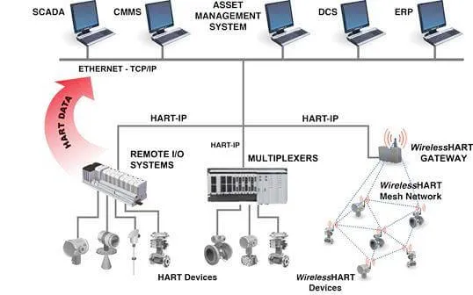
Wireless HART - Wireless Highway Addressable Remote Transducer (WirelessHART, WH) Protocol

Slide 6
*The Time Synchronized Mesh Protocol (TSMP)
TSMP enables
reliable,
low power,
secure communication
in a managed wireless mesh network.
Is a medium access and networking protocol designed for the recently ratified Wireless HART standard in industrial automation.
Benefits from synchronization of nodes in a multi-hop network to within a few hundred microseconds, allowing scheduling of
collision-free pair-wise and
broadcast communication to meet the traffic needs of all nodes
while cycling through all available channels.

Slide 7
*TSMP
Provides redundancy and fail-over in
time,
frequency and
space to ensure very high reliability even in the most challenging radio environments.
Also provides the intelligence
required for self-organizing,
self-healing mesh routing.
The result is
a network that installs easily with no specialized wireless expertise,
automatically adapts to unforeseen challenges, and
can be extended as needed without sophisticated planning.

Slide 8
*Five key components of TSMP
That contribute to end-to-end network reliability, simple installation and power efficiency.
Time synchronized communication
Frequency hopping
Automatic node joining and network formation
Fully-redundant mesh routing
Secure message transfer

Slide 9
*Features of TSMP
TSMP has been targeted to:
Reliability at low-power: >99.9% packet delivery with years of battery life for all nodes
Scalability: hundreds of meshed nodes per manager, thousands in the same RF environment
Flexibility: support different time-varying traffic patterns from different nodes
Security: guarantee confidentiality, integrity, and authenticity of all packets
Environment: nodes operate between -40°C and 85°C and in radically changing RF noise levels

Slide 10
*TSMP
A traditional approach to facilitate synchronization is - beaconing,
where longer frame lengths decrease the refresh rate at which synchronization is performed and
hence power consumption and
shorter frame lengths conversely invoke the opposite.
TSMP does refrain from doing so because it requires long listening windows which consume power.
Instead, TSMP nodes maintain a precise sense of time and exchange only offset information with neighbors to ensure alignment.
These offset values are exchanged during active periods together with the usual data and acknowledgement packets hence invoking negligible overhead.
TSMP nodes are active in three states:
1) sending a packet to a neighbor;
2) listening for a neighbor to talk; and
3) interfacing with an embedded hardware component.
The duration of active periods, i.e. the duty cycling, is very flexible in TDMA; typical applications require duty cycles of less than 1%.

Slide 11
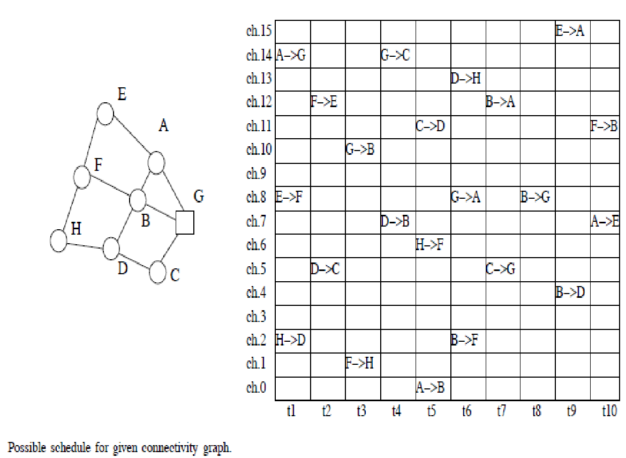
*TSMP
When applied, the sink typically retrieves
the list of nodes,
their neighbors and
their requirements in terms of traffic generation.
From this information, it constructs a scheduling table in both time and frequency.

Slide 12
*TSMP
When implementing TSMP on IEEE 802.15.4 compatible hardware, 16 frequency channels are available.
Exemplified by means of the scheduling table of Fig. 5, the TSMP link establishment and maintenance rules are simple:
never put two transmissions in the same time/frequency slot;
at a given time, a given node should not receive from two neighbors nor have to send to two neighbors.

Slide 13
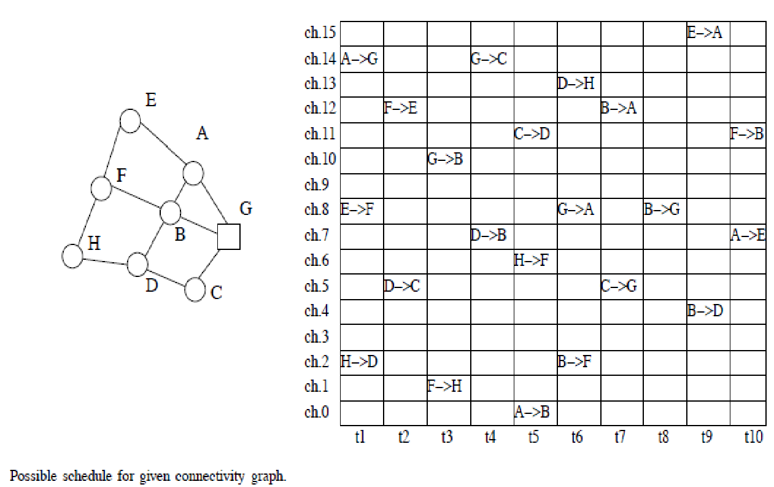
*
Assuming that slots are 10ms long and node H sends a packet following route H → F → B → G, then H sends to F in slot [t5, ch.6], thereafter F → B in [t10, ch.11], then B → G at [t8, ch.8].
Latency is hence in this particular case 13 slots (130ms) and in general always guaranteed to be bound by a finite value which depends on the particular design of the time-frequency pattern.

Slide 15
https://www.opensourceforu.com/2022/02/choose-the-most-optimal-iot-protocol-for-your-project/
https://www.techtarget.com/iotagenda/tip/Top-12-most-commonly-used-IoT-protocols-and-standards

Slide 16
M6-Applications

Slide 17
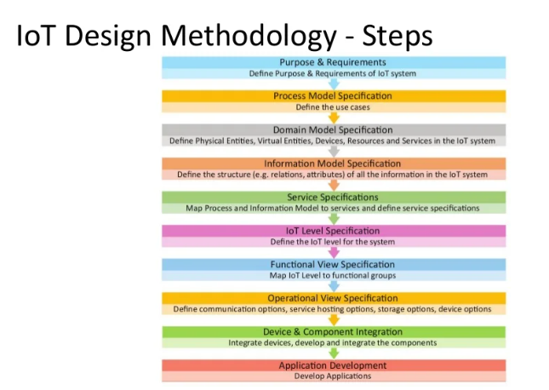
Home Automation - Home lighting, Home Intrusion detection

Slide 18
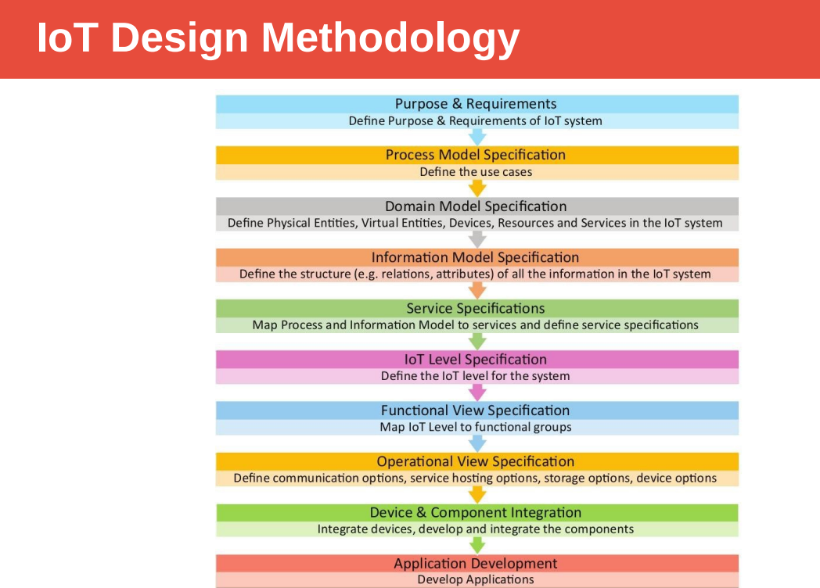

Slide 19
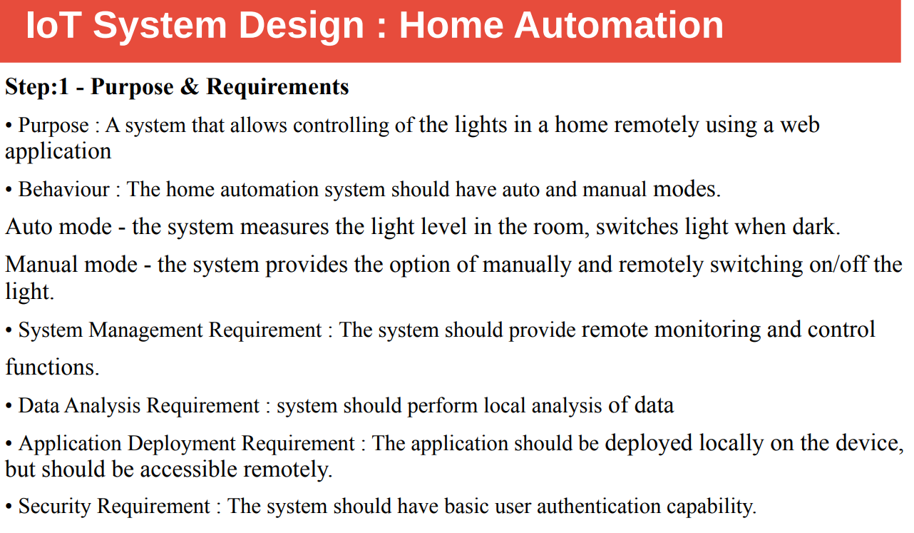

Slide 20
Home-Intrusion Detection System
Purpose and requirement specification
the purpose of the home intrusion detection system is to detect intrusion using sensor such as sensors and door sensor and raise alerts if necessary
Behaviour:
Each room in the home has a PIR motion sensor and each door has a door sensor. These sensors can detect motion or the opening of the door. Each sensor is read at regular intervals and motion detection or door opening events are stored and alerts are sent
System management requirements:
the system should detect the intrusion and send an alert on detecting an anomaly
Data analysis requirement:
the system should perform local analysis of the data
Application deployment requirement: The application should be deployed locally on the device but should be accessible remotely

Slide 21
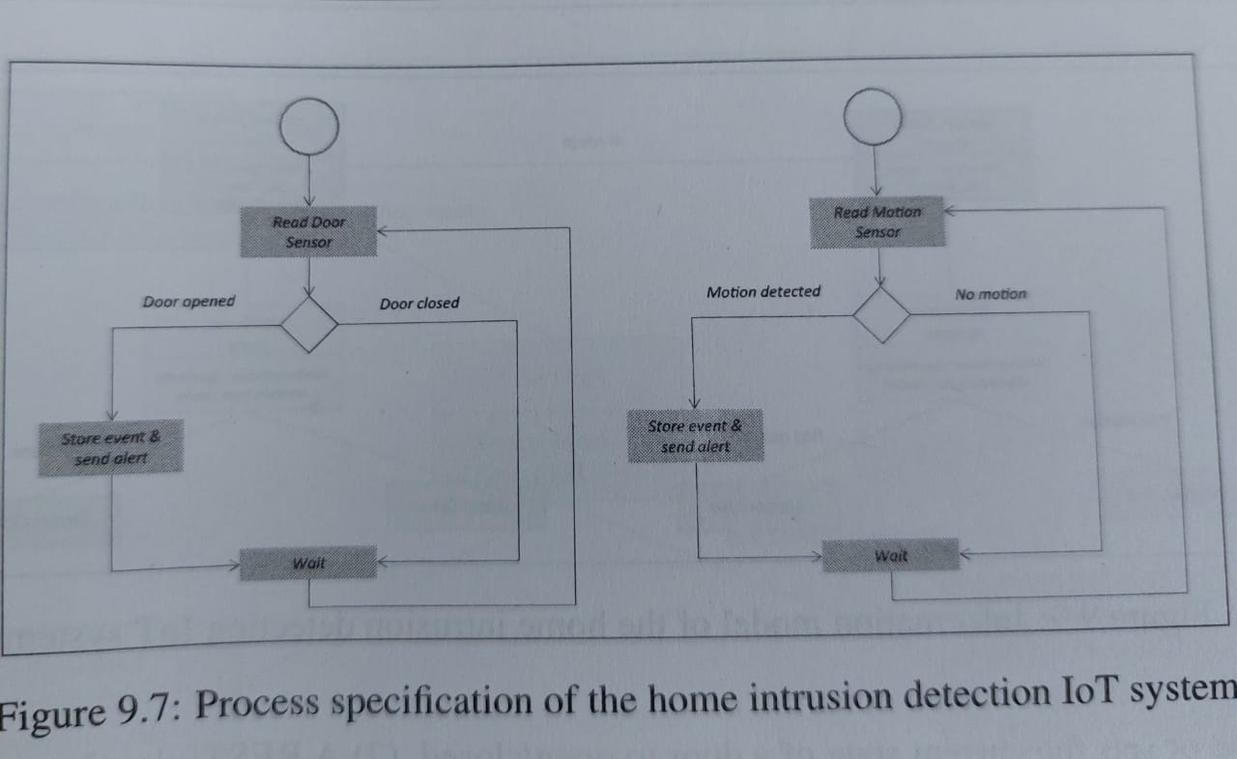
Process specifications

Slide 22
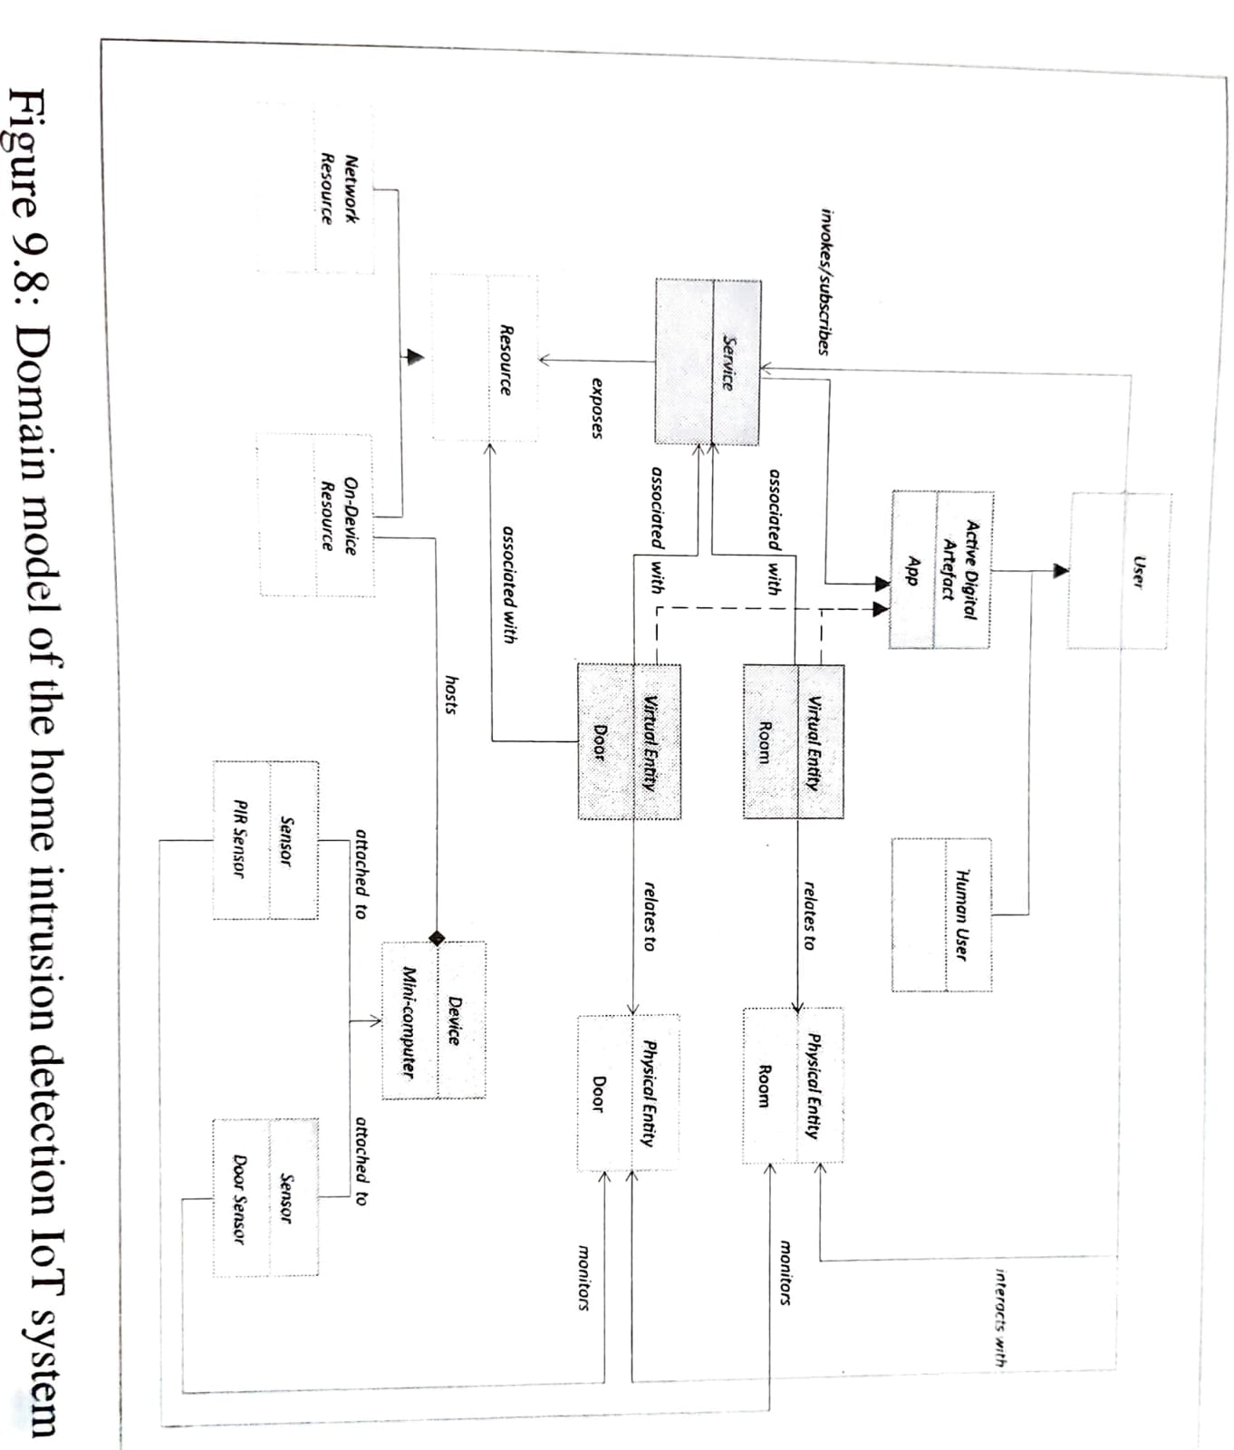

Slide 23
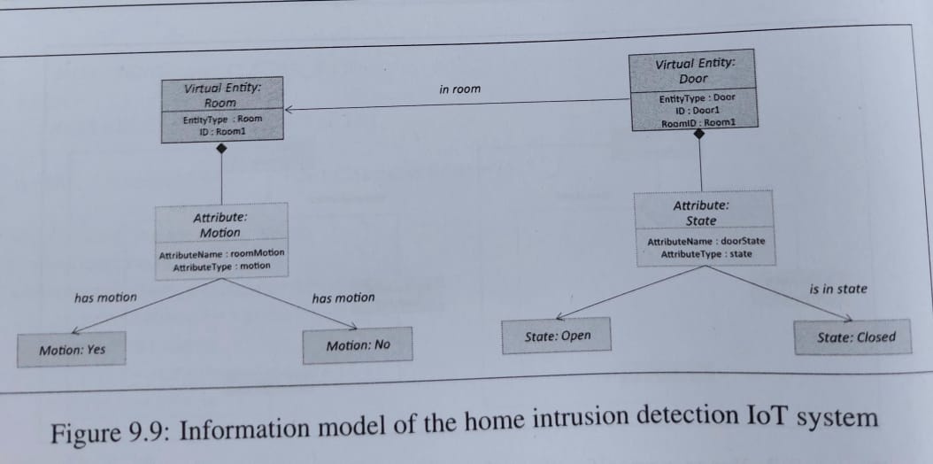
Information Model

Slide 24
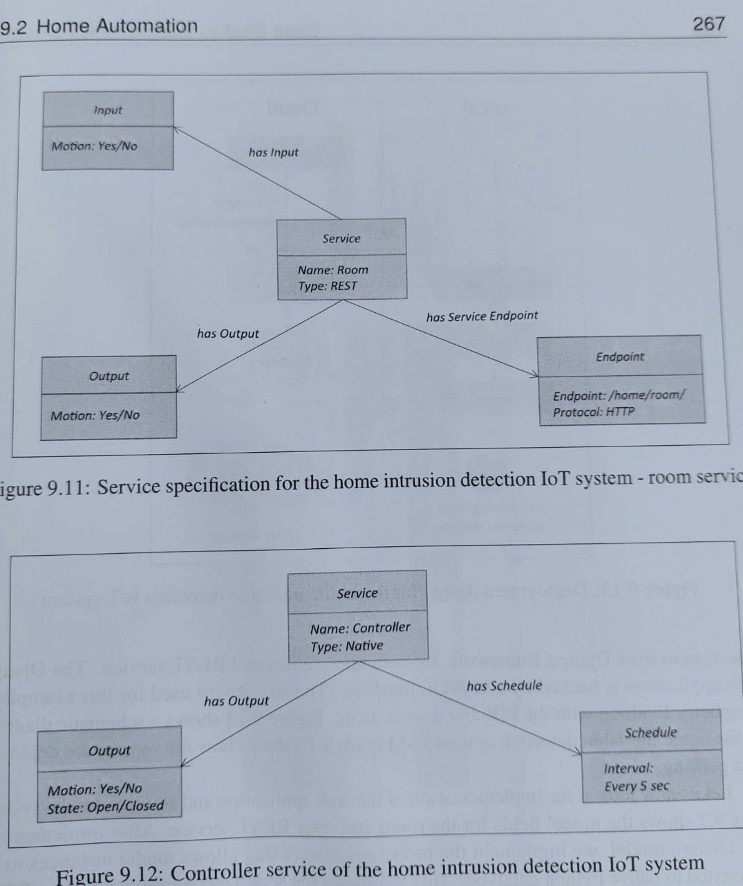
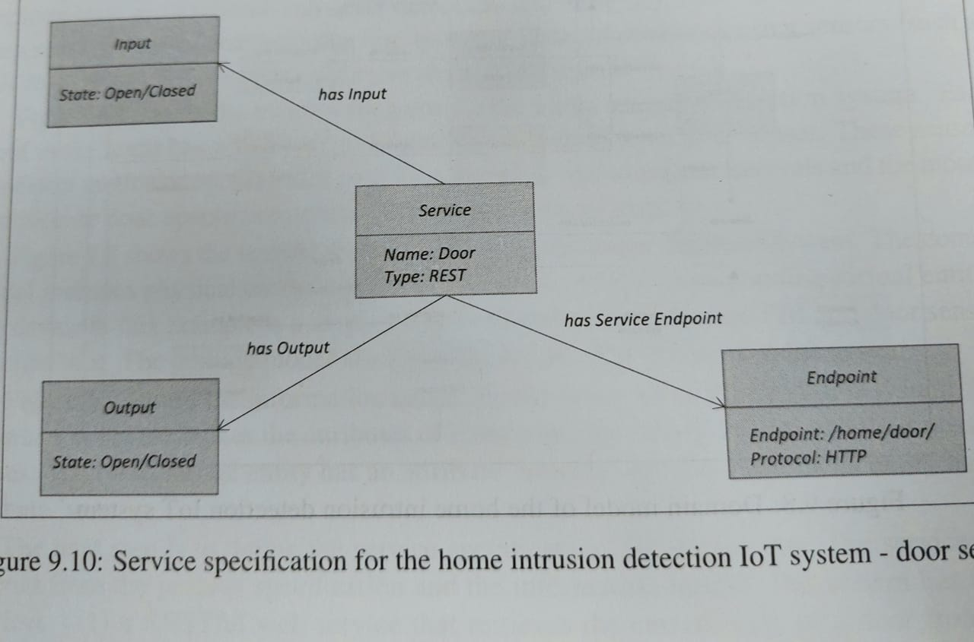
Service specifications

Slide 25
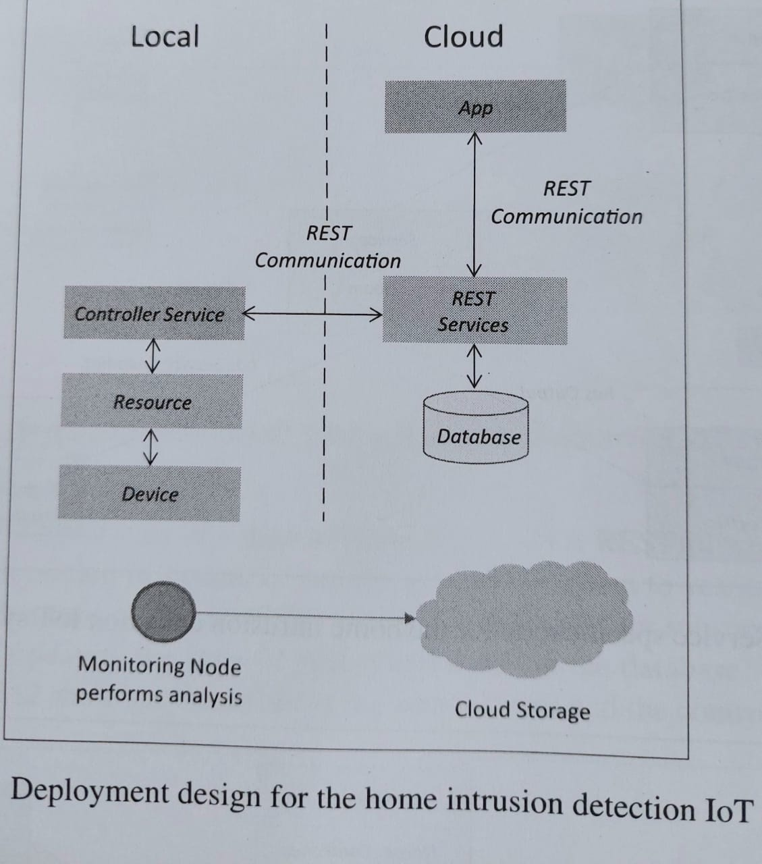
Deployment

Slide 26
Smart Parking
The purpose of a smart parking system is to detect the number of empty parking slot and send information over the internet to smart parking system backend
These applications can be accessed by drivers from smartphones, tablets or from in-car navigation system.
In smart parking, sensors are used for each parking slot to detect whether the slot is empty or occupied.
This information is aggregated by a local controller and then sent over the internet to a server.

Slide 27
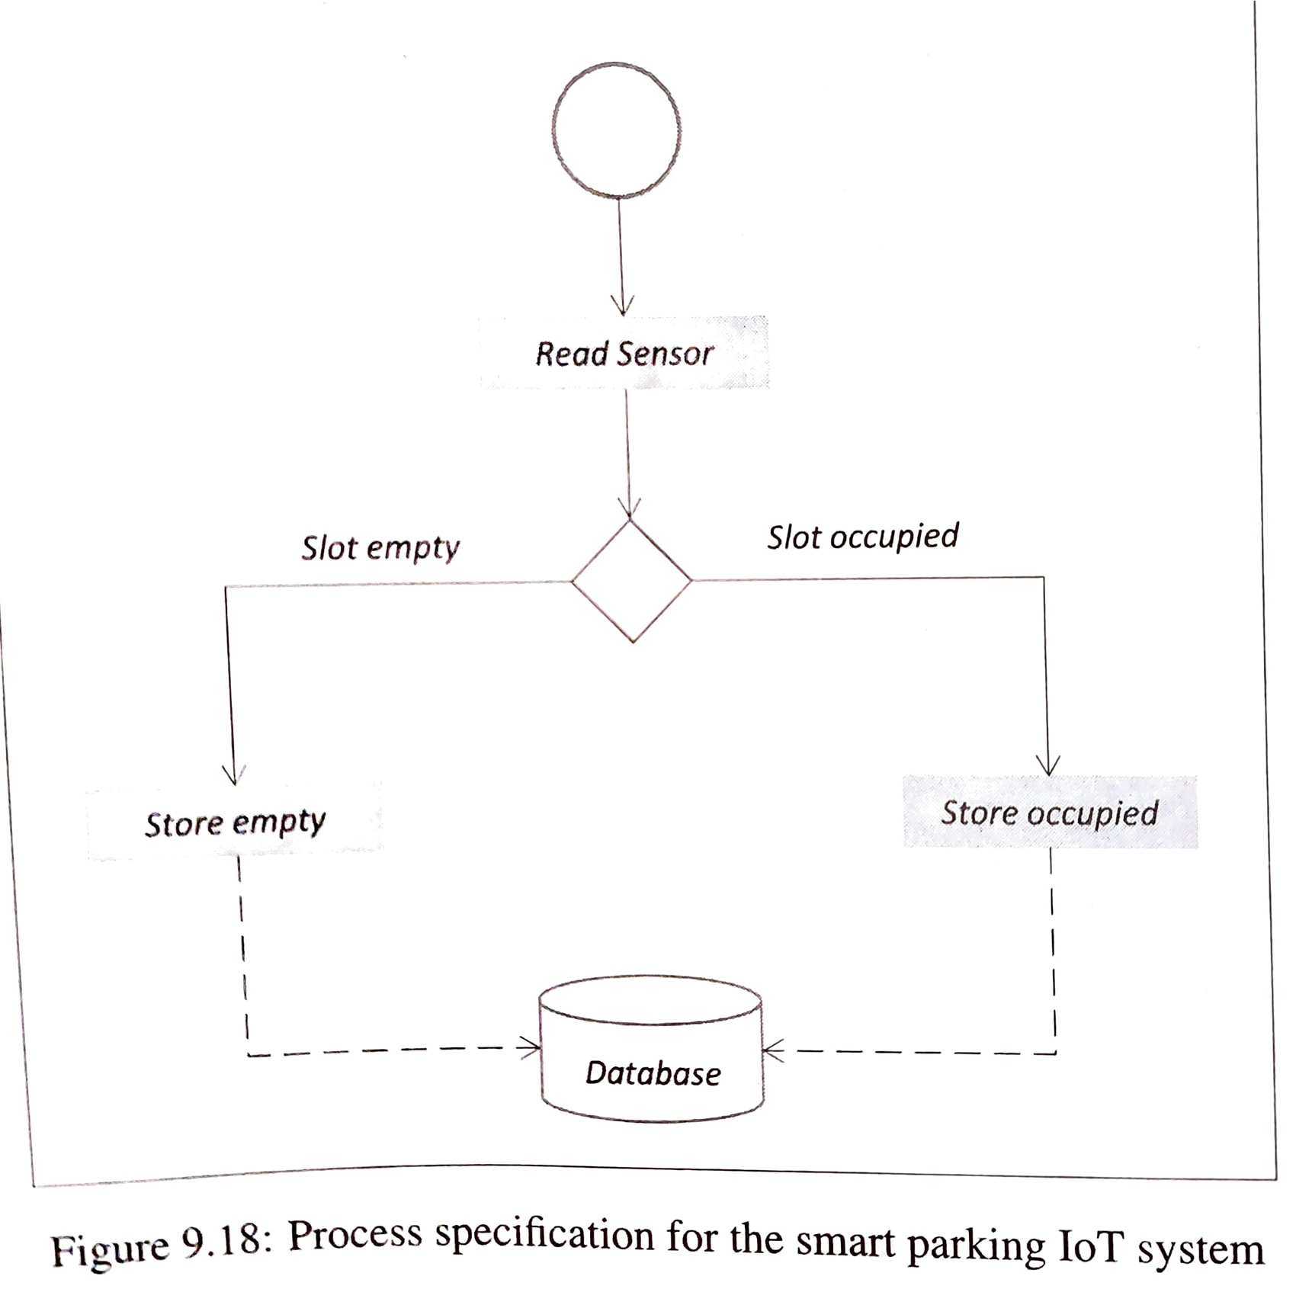
Process diagram
Each parking slot has an ultrasonic sensor fixed above which can detect the presence of a vehicle in a slot
Each sensor is read at regular intervals and the state of the parking slot - empty/occupied is updated in a database

Slide 28
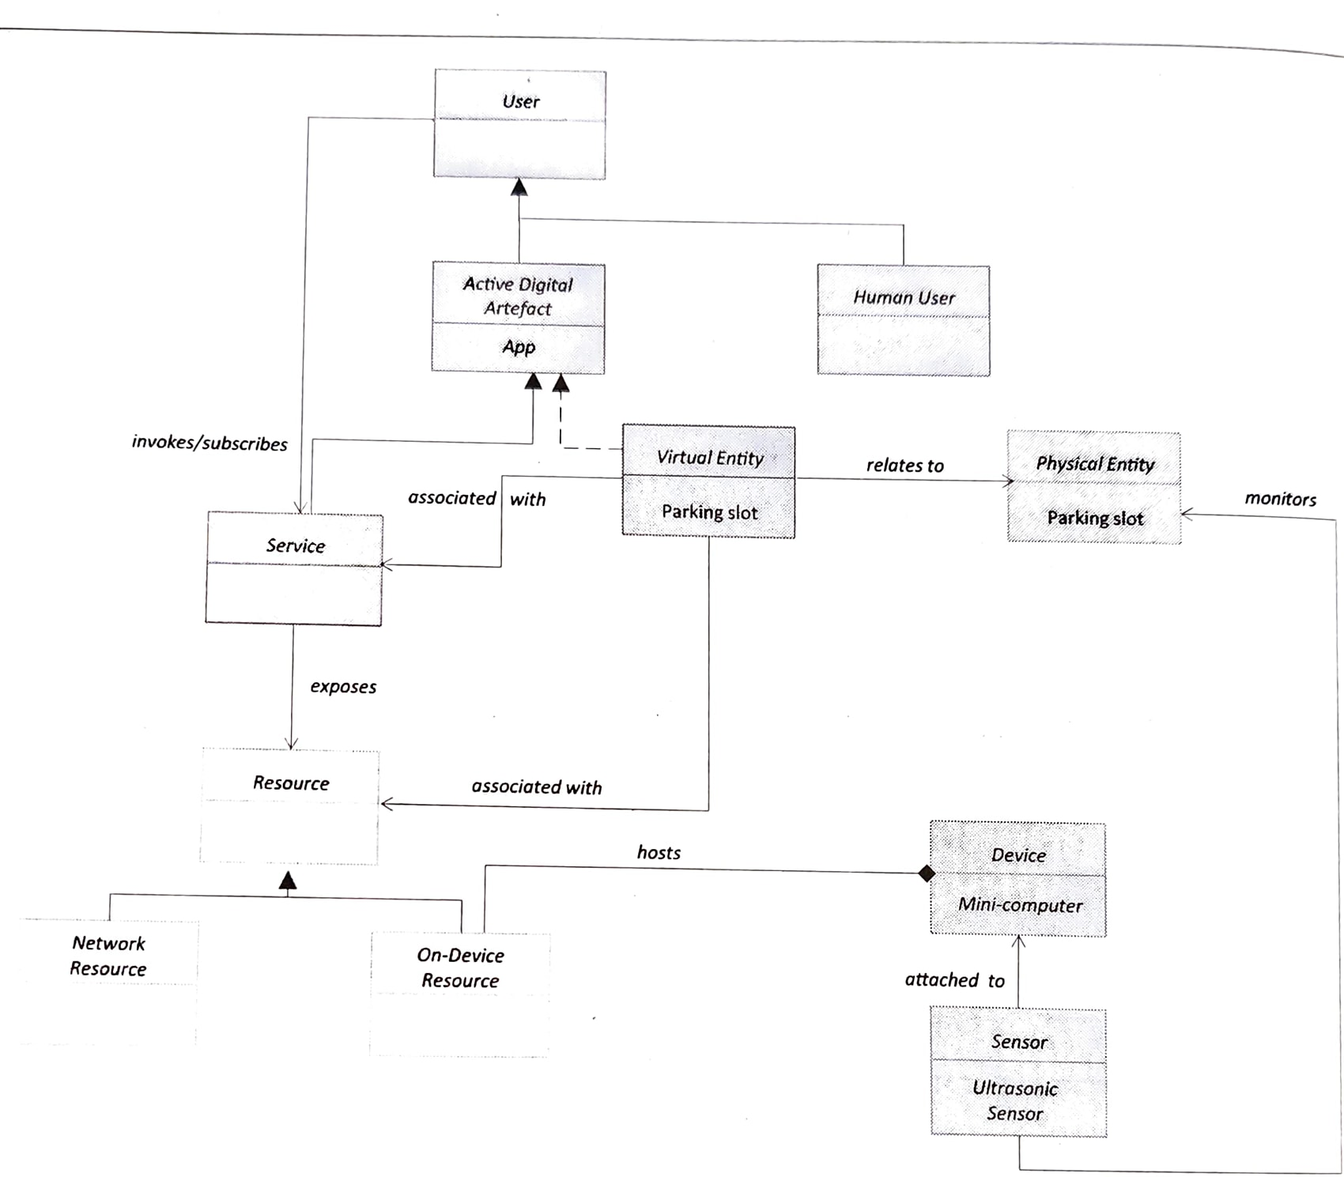
Domain model
It includes a physical entity for the parking slot and the corresponding virtual entry
The device is a single-board mini computer which has ultrasonic sensor attached to it.
It also includes the services involved in the system

Slide 29
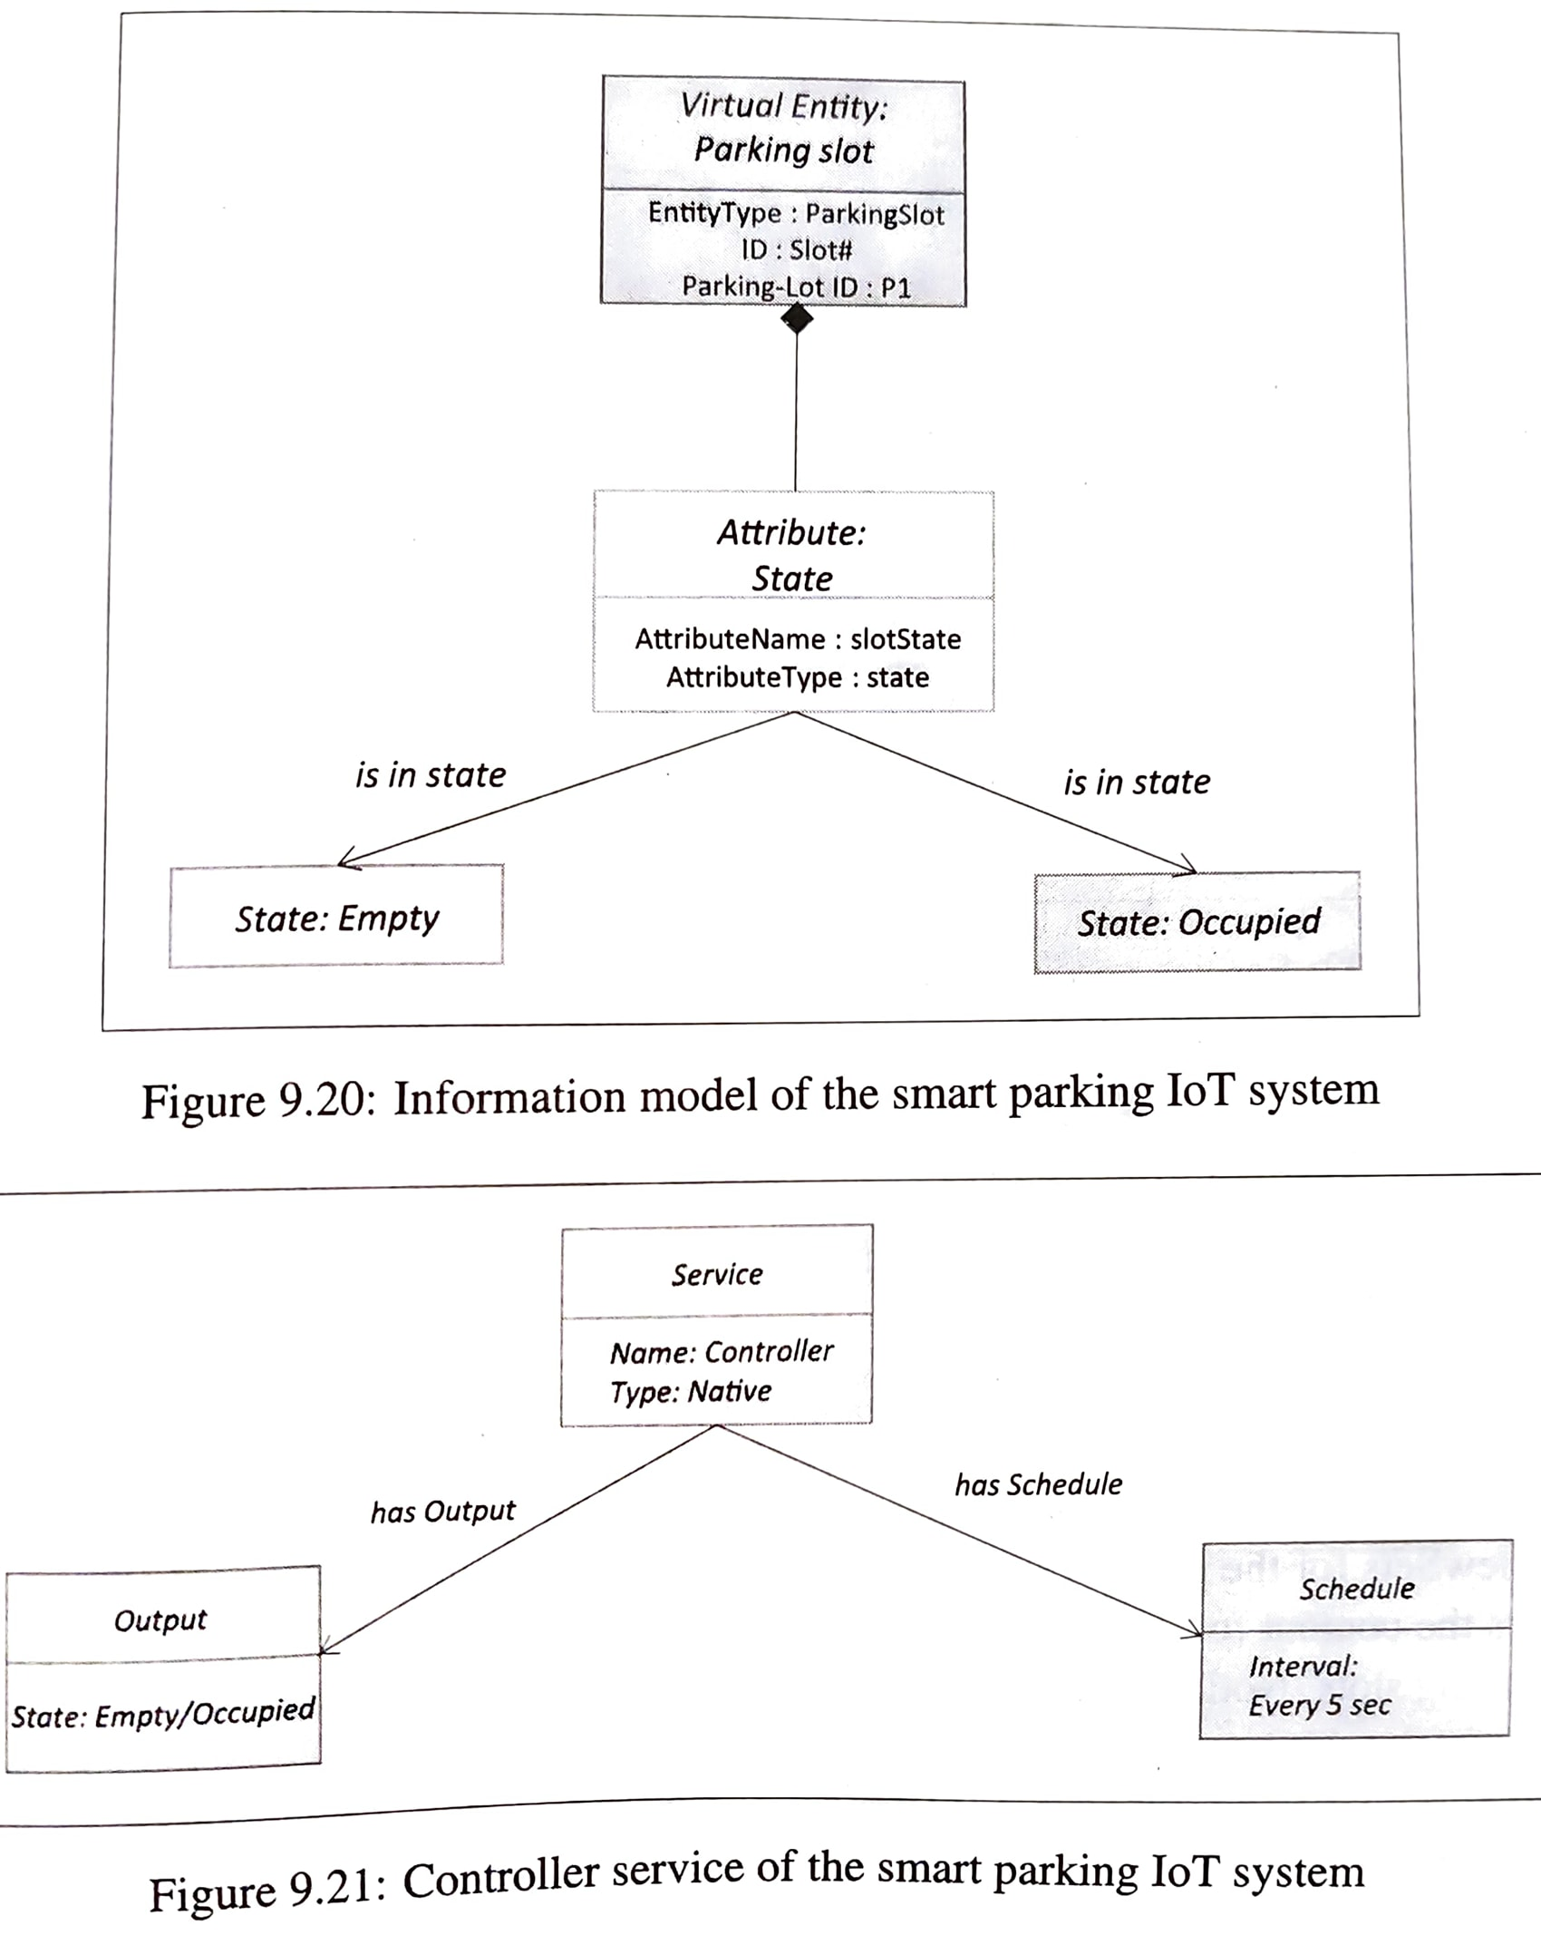
Information model
It defines the attributes of the parking slot virtual entity with two possible values - empty or occupied

Slide 30
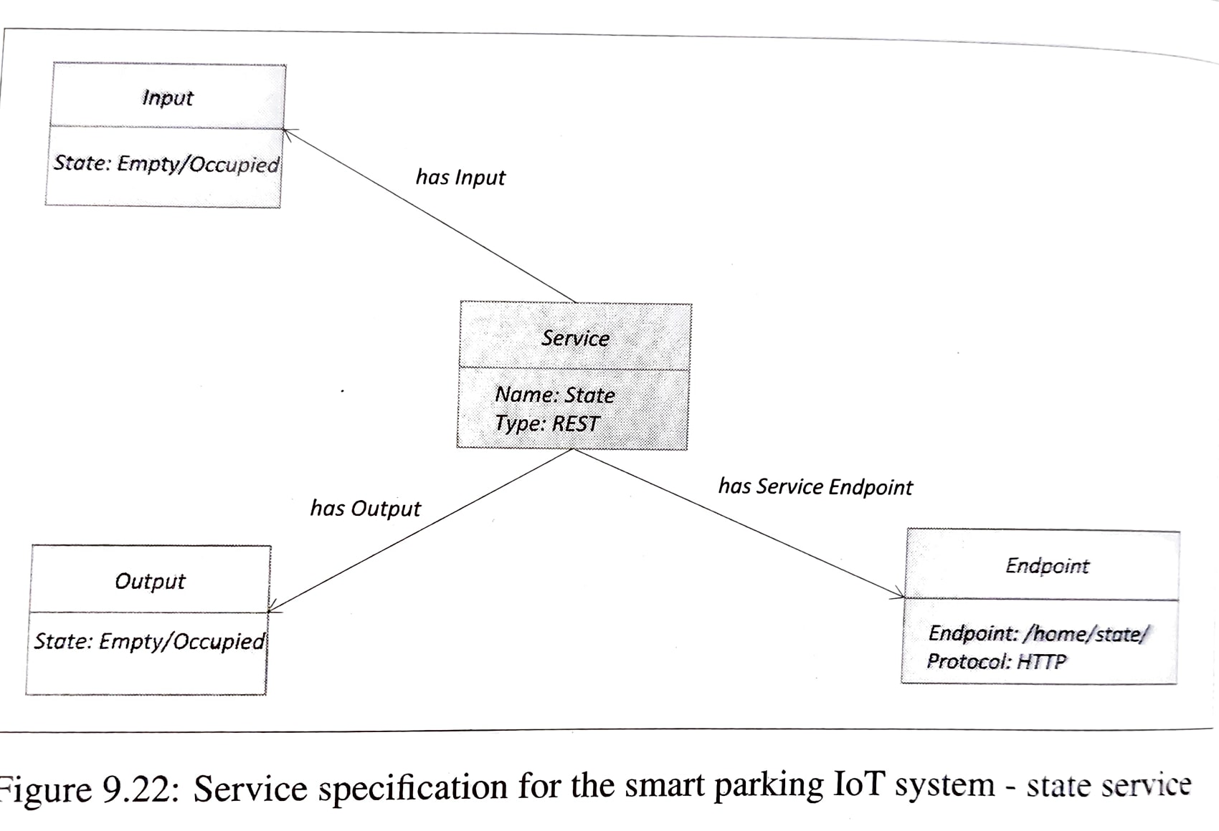
Service specifications
The services are derived from the process

Slide 31
Deployment
Connectivity to the App is not the current requirement
If yes - then this will be done through REST
Smart parking system

Slide 32
Weather monitoring system
The purpose of the weather monitoring system is
to collect data on environmental conditions such as temperature, pressure, humidity and light in an area using multiple end nodes and send the data to the cloud where the data is aggregated and analyzed.

Slide 33
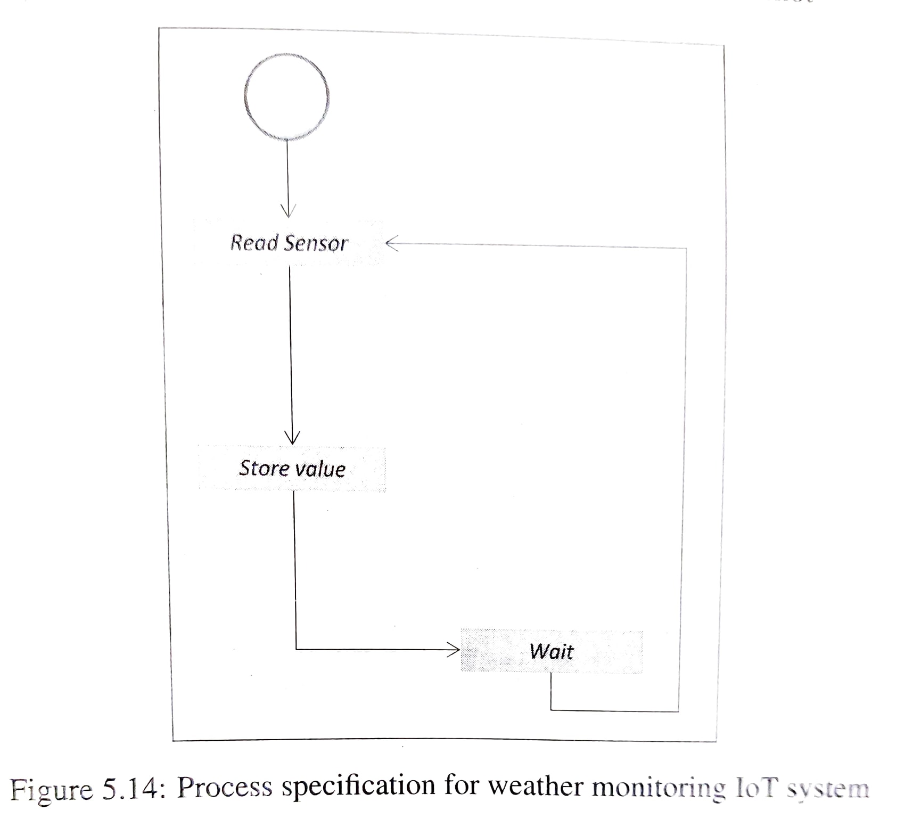
Process specifications
process specification shows that the senses are read after fixed intervals and the sensor measurement are Stored

Slide 34
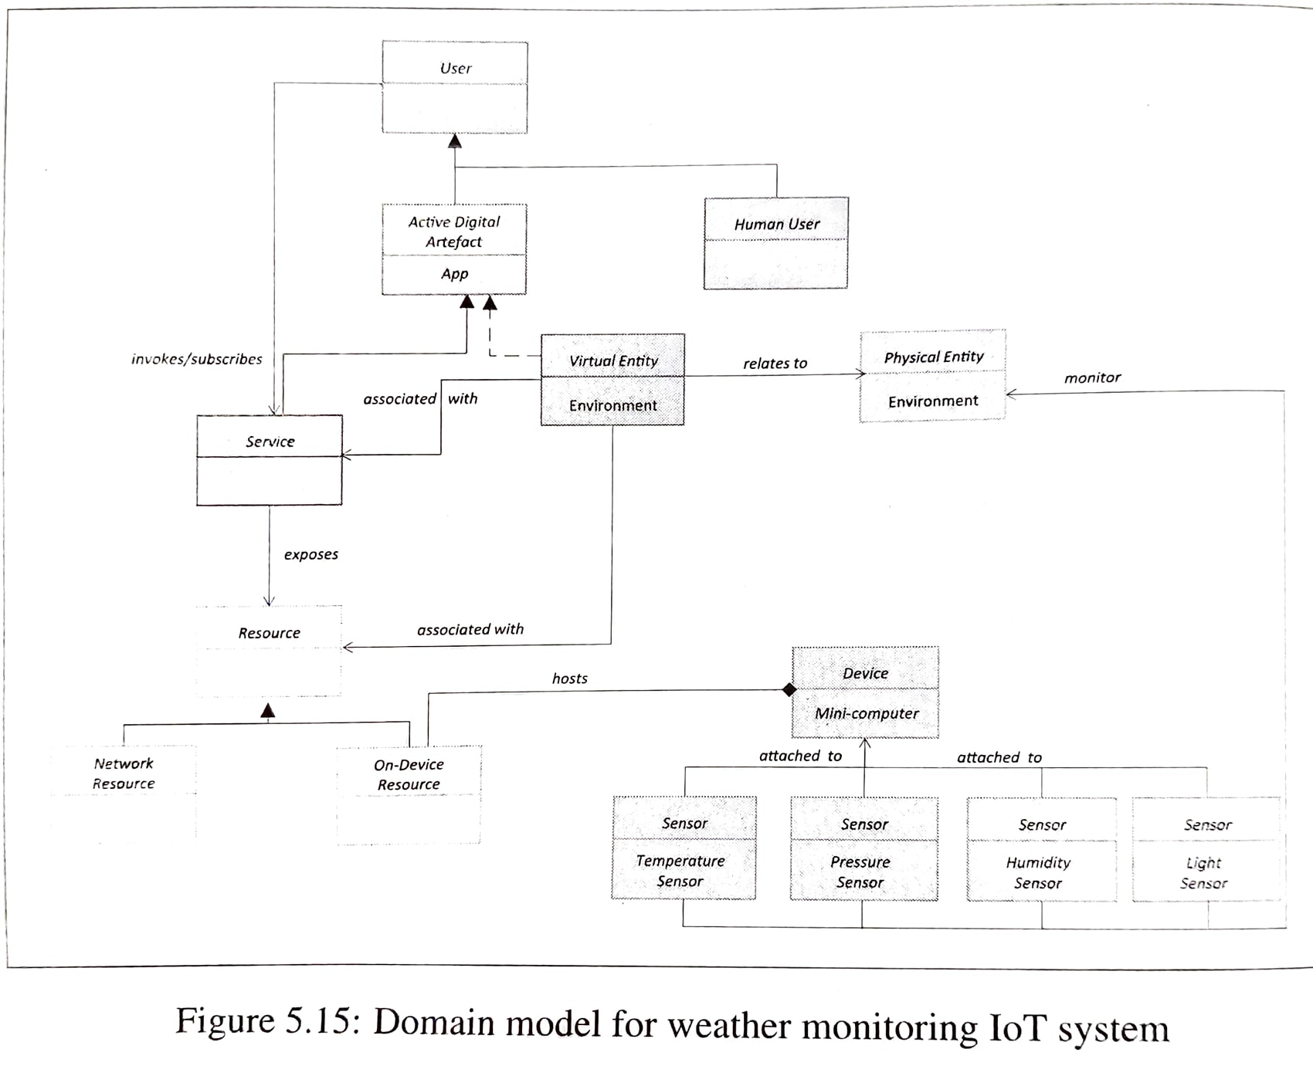
Domain model
In this domain model the physical entity is the environment which is being monitored.
There is a virtual entity for the environment.
Devices include temperature sensor, pressure sensor, humidity sensor, light sensor and single board mini computer.
Resources are software components which can be either on device or network resources.
Services includes the controller service that monitors the temperature, pressure, humidity and light and sends the readings to the cloud

Slide 35
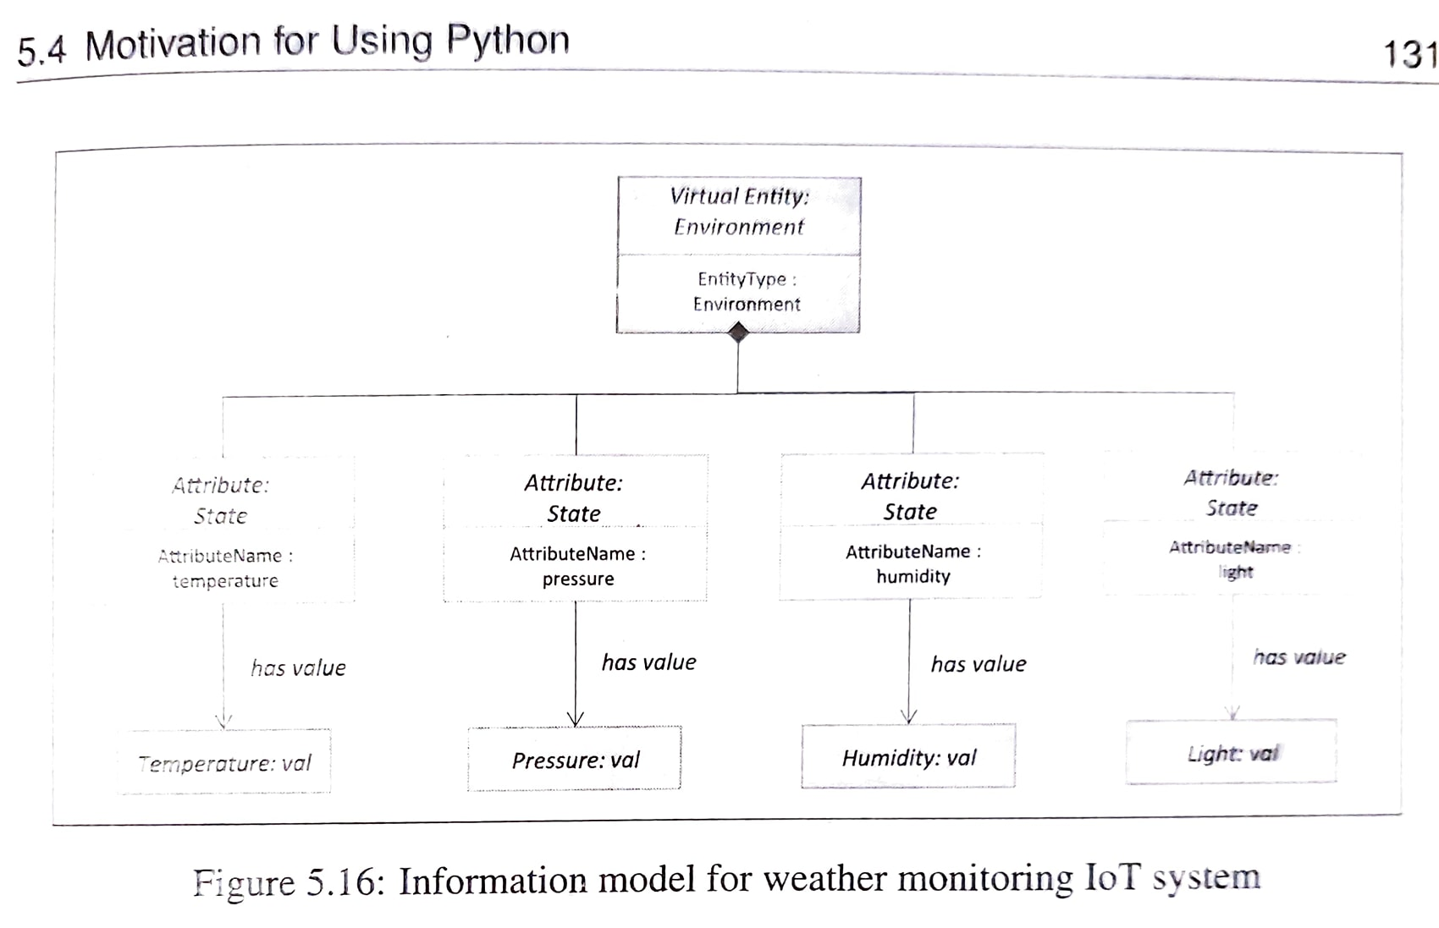
Information model
In the information model, there is one virtual entity for the environment being sensed. The virtual entity has attributes- temperature, pressure, humidity and light

Slide 36
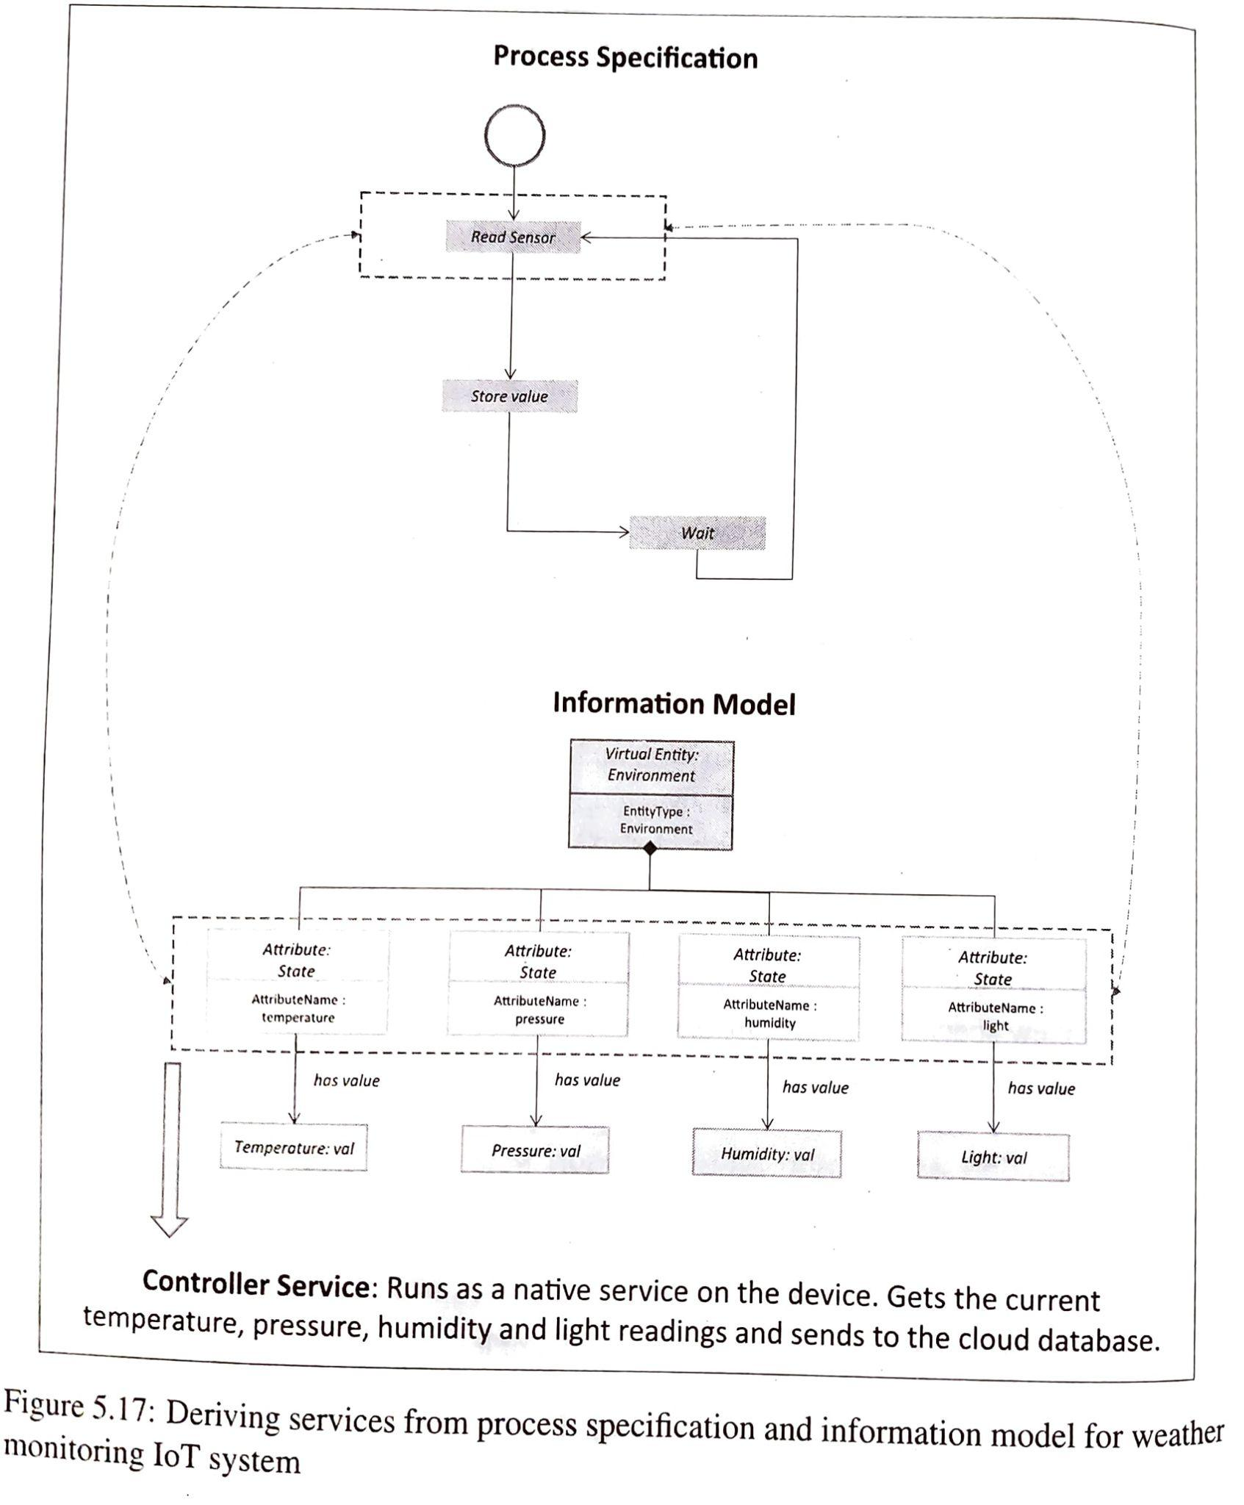
Controller service
The controller service runs as a native service on the device and monitors temperature, pressure, humidity and light once every 15 seconds
the controller service calls the REST service to store these measurements in the cloud

Slide 37
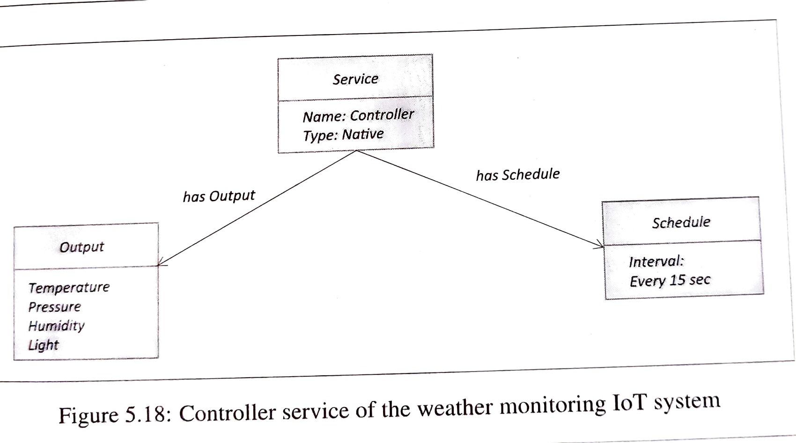

Slide 38
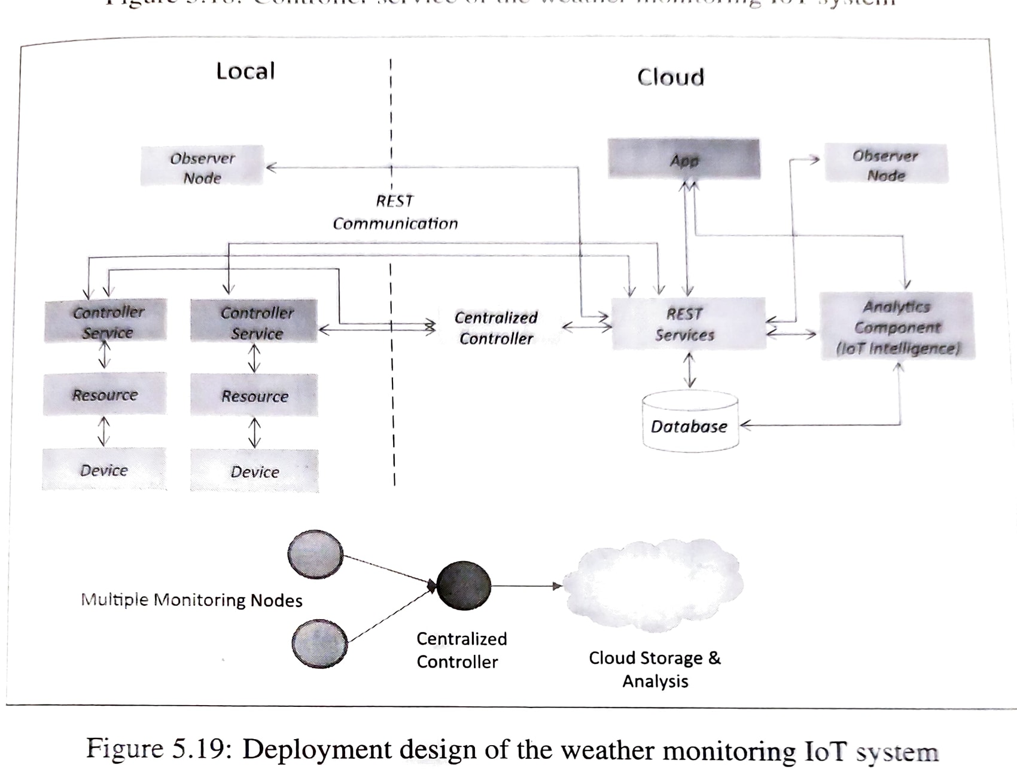

Slide 39
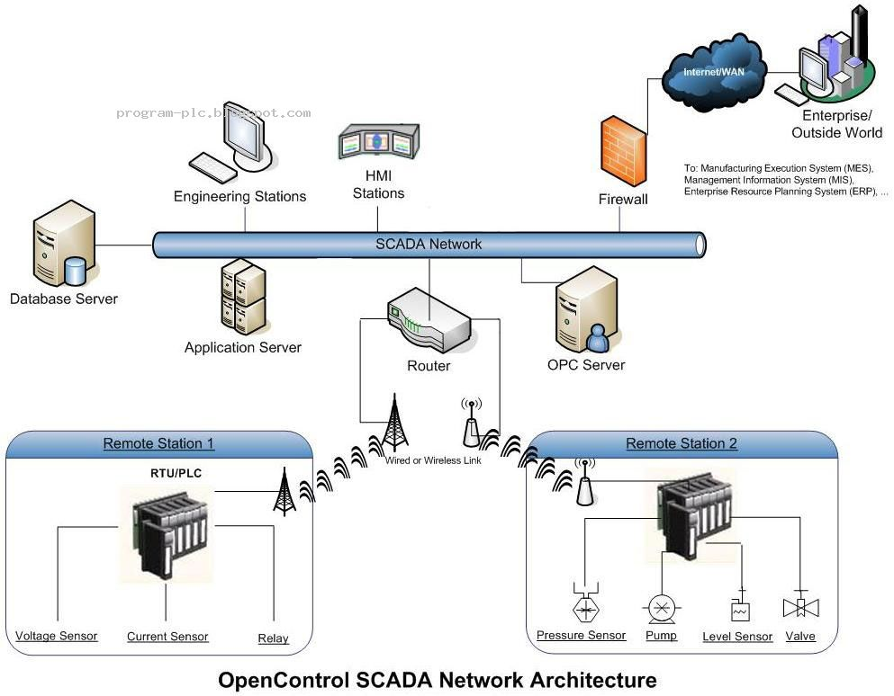
I-IoT 4.0
Observer node Cloud
Observer node local
Centralized controller
Local controller/Coordinator node

Slide 40
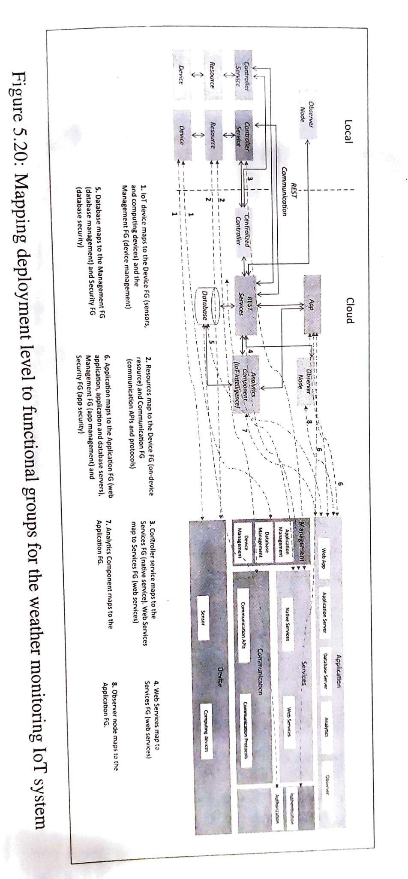

Slide 41
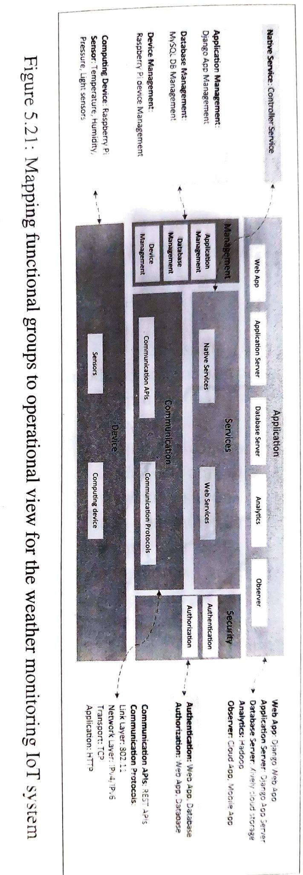

Slide 42
Case Studies

Slide 43
Weather reporting bots
Purpose: End node comprising of Rpi, temperature, humidity and pressure and light sensors.
And a USB webcam to click the photo of the environment
Controller service: obtains temperature, humidity and pressure and light sensors, every 30 sec. And at the same time an image is captured from the webcam- attached to the device.
The sensor readings and the image captured from the webcam attached to the device sent as a tweet on Twitter.
To send tweets the controller service uses a Python library for Twitter called tweepy

Slide 44
Air pollution Monitoring
Purpose: monitors emission of harmful gases by factories and automobiles using gaseous and meteorological sensors.
Design steps are similar to the weather monitoring system
System consists of multiple nodes placed in different locations for monitoring air pollution in an area.
The end nodes are equipped with CO and NO2 sensors.
The end nodes send the data to the cloud and the data is stored in a cloud database.
The cloud based application is used for visualizing the data.
Ri-Pi, MICS-2710 NO2 sensor and MICS-5525 CO sensor and ADC
Obtains reading every 10sec.

Slide 45
Forest Fire Detection
Purpose: uses a number of monitoring nodes deployed at different locations in a forest.
Each monitoring node collects measurements on ambient conditions (such as temperature and humidity) to predict whether a fire has broken out.
The system is based on a level-5 IoT deployment with multiple end nodes and one coordinator node collects data from the end nodes and sends to the cloud.
Rpi, DHT-22 temperature and humidity sensor. XBee module is used for wireless communication between the end-nodes and the coordinating nodes
The controller service: receives a data from all end nodes and calls the REST service to store these measurements in the cloud.

Slide 46
Agriculture: Smart Irrigation
Purpose: uses IoT devices and soil moisture sensors to determine the amount of moisture levels go below a predefined threshold.
Data on the moisture level is collected in the cloud where it is analyzed to plan watering schedule.

Slide 47
IoT printer
Purpose: to print a daily briefing every morning.
The daily briefing comprises of the current weather information, weather predictions for the day and the user’s schedule for the day (obtained from the user’s Google Calendar account)

Slide 48
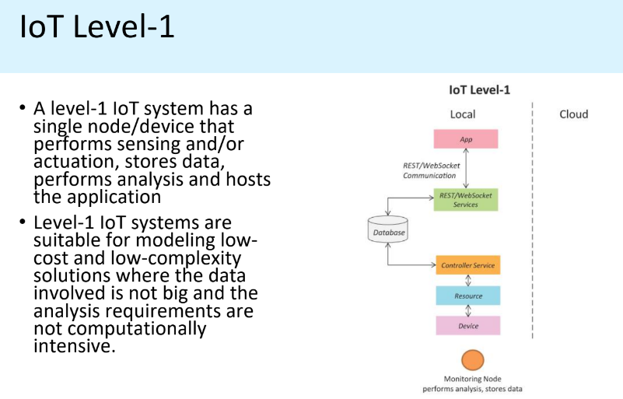
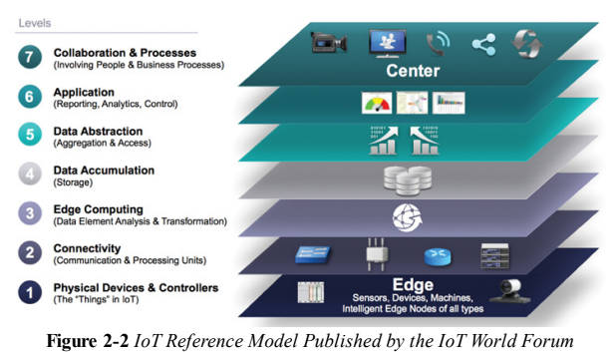
Layers 1, 2
Example: Consider an IOT device that monitors the lights in a house.
The lights are controlled through switches.
Status of each light is maintained in a local database.

Slide 49
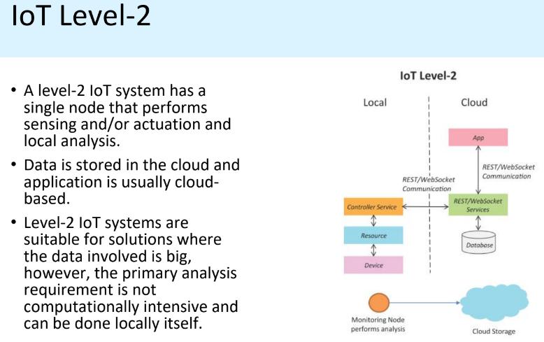
Layers 1, 2, 3 (may or may not) and 4
Ex: A single node monitors the soil moisture in the field.
This is sent to the database on cloud using REST APIs.
Controller service continuously monitors moisture levels.
Node has processing capability

Slide 50
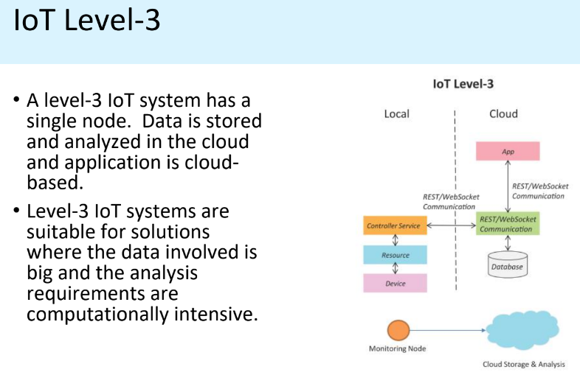
Layers 1 to 6
Example: A node is monitoring a package using devices like accelerometer and gyroscope. Needed to monitor the activity for a longer duration
Analysis/Processing capability shifted to Cloud

Slide 51
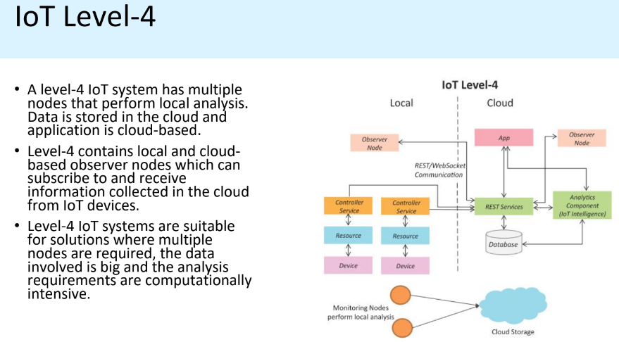
Layers 1 to 6
Observer nodes can process information and use it for applications but do not perform control functions.
Example: Noise monitoring of a area requires various nodes functioning independent of each other.
Each has its own controller service.
Data is stored in cloud database.
Analysis is done on the cloud and the entire IOT system is monitored on the cloud using an application.
Analysis/Processing capability at local level + Topology - one to one
IOT level 4 - Multiple nodes collect information and store in the cloud.
A cloud based application controls the system.
Local and remote observer nodes are present that subscribe to and receive information collected in cloud from various devices.

Slide 52
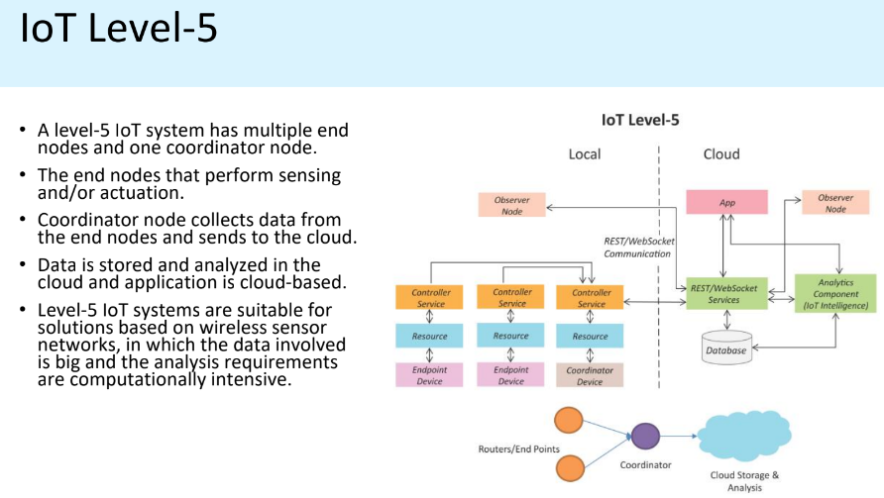
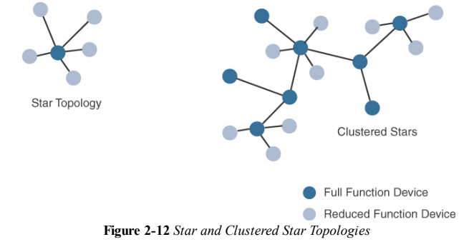
The sensor which can implement a subset of protocol functions to perform just a specialized part (communication with the coordinator). Such a device is called a reduced-function device (RFD).
An RFD cannot be a coordinator. An RFD also cannot implement direct communications to another RFD.
The coordinator that implements the full network functions is called, by contrast, a full-function device (FFD).
Layers 1 to 6
WSN - point to multipoint topology
Example: A monitoring system has various components: end nodes collect various data from the environment and send it to coordinator node.
Coordinator node acts as gateway and allows the data to be transferred to cloud storage using REST API.
Controller service on the coordinator node sends data to the cloud.
IOT level 5-Nodes present locally are of two types : end nodes and coordinator nodes.
End nodes collect data and perform sensing or actuation or both.
Coordinator nodes collect data from end nodes and sends it to cloud.
Data is stored and analysed in cloud and application is cloud based.

Slide 53
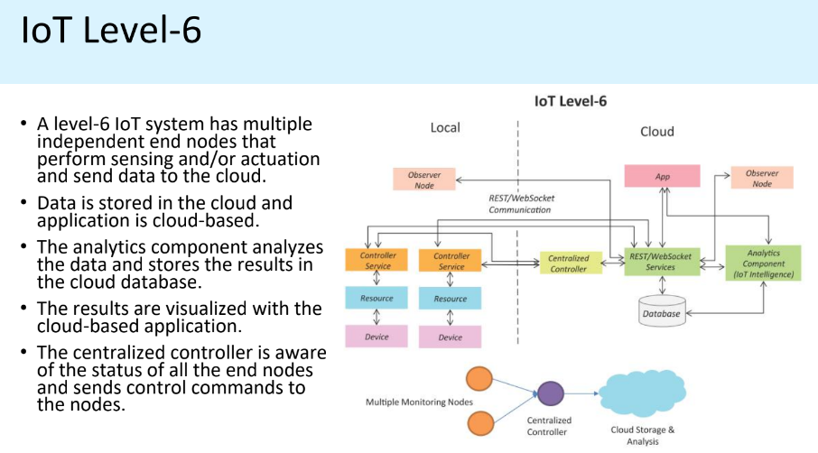
Layers 1 to 6 - Centralized Controller to monitor the status of the node
Example: Weather monitoring consists of sensors that monitor different aspects of a system.
The end nodes send data to cloud storage.
Analysis component, application and storage are in cloud.
Centralized controller controls all nodes and provides inputs.
IOT level 6- Multiple independent end nodes perform sensing and actuation and send data to cloud.
Data is stored in cloud and application is cloud based. The analytics components analyses the data and stores the results in the cloud database.
The results are visualized with cloud based application. The centralized controller is aware of the status of all the end nodes and sends control commands to the node.

Slide 55
Assignment M6:
All the defaulters are expected to prepare the IOT design for the following applications as per the IOT design methodology steps:
Home
Cities
Environment
Energy Systems
Retail
Logistics
Industry
Agriculture
Health and Lifestyle

Slide 56
Home Automation:
Smart Lighting
Smart Appliance
Smoke/Gas detection
Any other
Cities
Smart Lighting
Smart Roards
Structural Health Monitoring
Survelliance
Emergency response
Noise pollution detection - x
Environment
Weather monitoring - x
Air pollution monitoringx-x
River Floods Detection
Forest Fire detection
Energy
Smart Grids
Rebewable energy system
Prognostics
Retai
Inventory management
Smart Payments
Smart Vending Machinesl
Logistics
Route generation and scheduling
Shipment Monitoring
Fleet Tracking
Remote Vehicle Diagnostics

Slide 57
Agriculture
Smart Irrigation - x
Green House Control
Industry
Machine Diagnosis and Prognosis
Indoor Air Quality Monitoring
Health and Lifestyle
Health and Fitness Monitoring
Wearable Electronics

Slide 58
Assignment 1: Analytics
Demonstrate the various outcomes of the analytics that can be applied to various applications like
Home
Cities
Environment
Energy Systems
Retail
Logistics
Industry
Agriculture
Health and Lifestyle

